Slide 1

Identifying cardiovascular Heart disease Risks Based on
Analysis of Framingham Heart Study
CV Age motivates people to achieve risk factor targets!
Project 1: Healthy Tuples

Slide 2
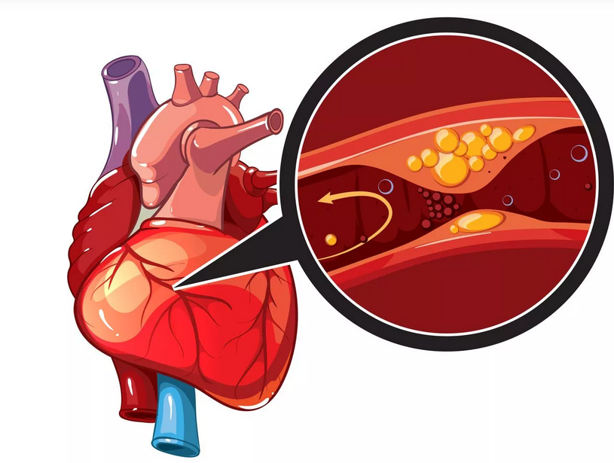
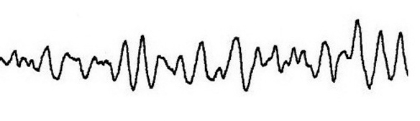
Background
Heart disease is a major cause of morbidity and mortality globally
Coronary heart disease most common in the US
Every 40 seconds
805,000 Americans yearly
How do we approach this?
The Framingham Heart Study (FHS)
Commissioned by Congress – first study of its kind
To determine people “at risk” for heart disease
Began with over 4000 participants
now on its 3rd generation
Mahmood SS, Levy D, Vasan RS, Wang TJ. The Framingham Heart Study and the epidemiology of cardiovascular disease: a historical perspective. Lancet. 2014;383(9921):999-1008. doi:10.1016/S0140-6736(13)61752-3

Slide 3
How did we approach this data set?
Obtained from website: https://www.nhlbi.nih.gov/science/framingham-heart-study-fhs
4240 participants, 15 attributes
Sex
Age
Education Level
Current Smoker
Cigs per day
History of blood pressure medications
History of stroke
History of Hypertension
History of Diabetes Mellitus
Total Cholesterol
Systolic Blood Pressure
Diastolic Blood Pressure
Body Mass Index
Heart Rate
Glucose
Target Variable:
10 year risk of Coronary Heart Disease

Slide 4
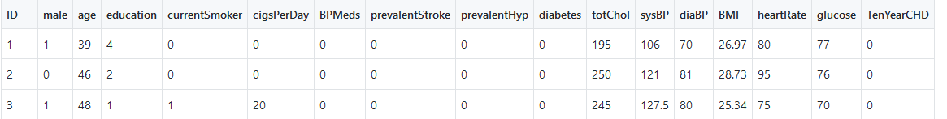
Data Set Clean Up
Checked for Data Type (i.e. integer, boolean)
Checked for Duplication
Checked Null Values
Dropped Null Values
Descriptive Analysis of the Data
Coded Data Into Graphs

Slide 5
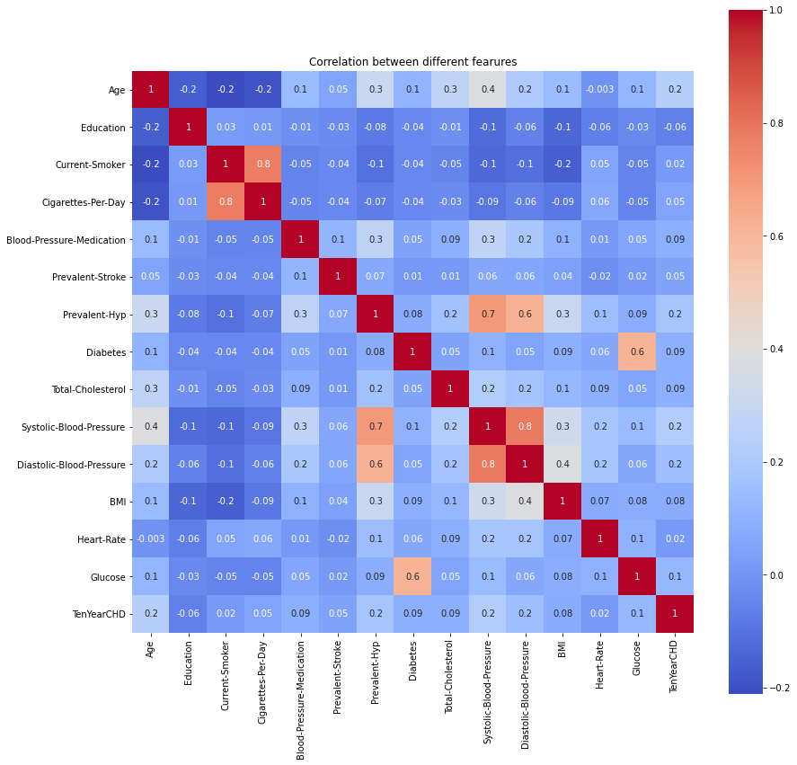
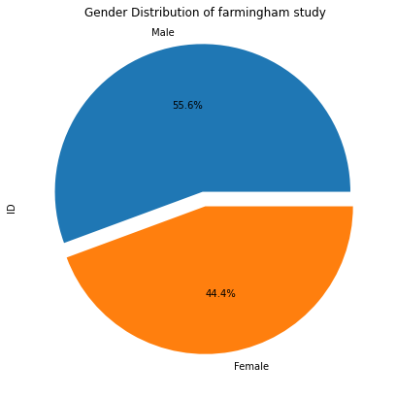
What is the spread of each attribute in the given data set ?

Slide 6
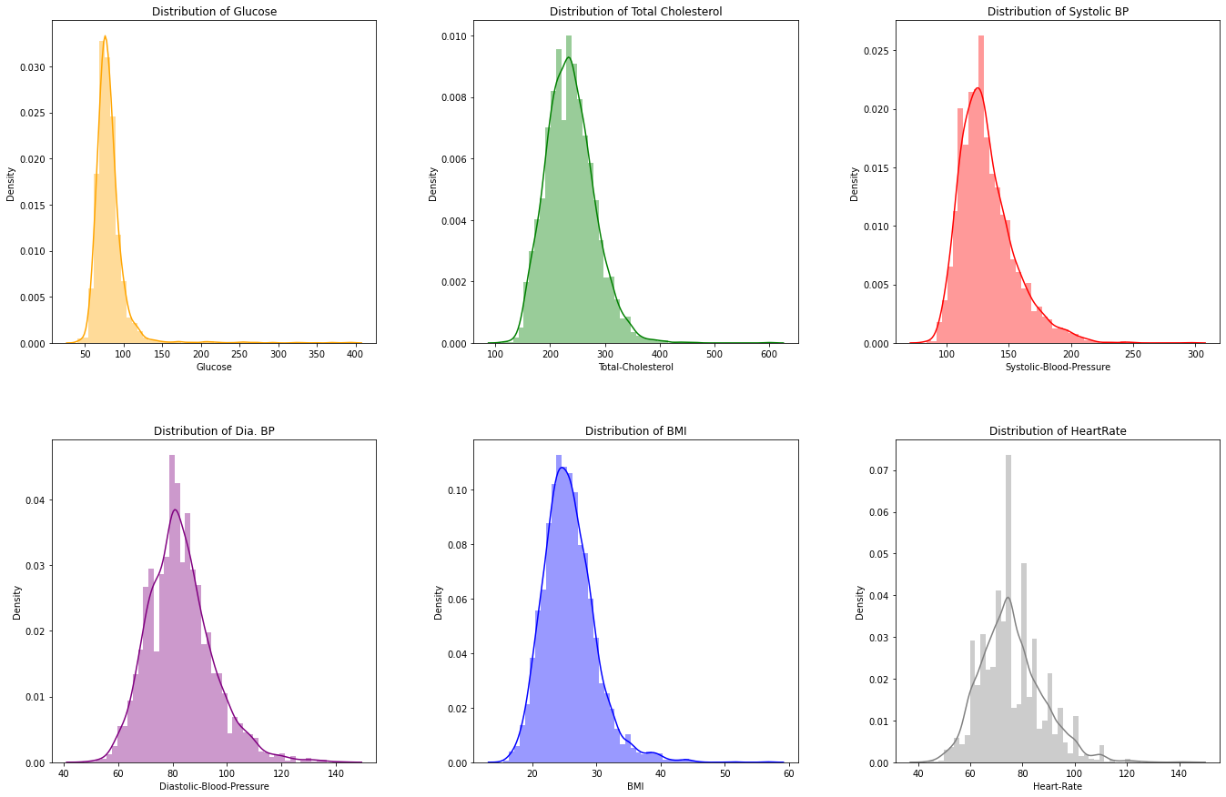
Glucose, Total Cholesterol, Systolic BP & BMI is Right Skewed while, Diastolic BP & Heart Rate are close to Normal distribution. Heart-Rate has highly uneven distribution in the data set.

Slide 7
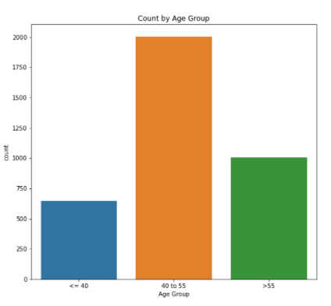
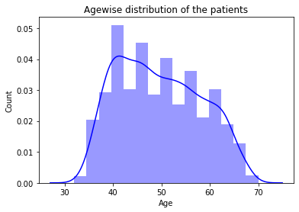
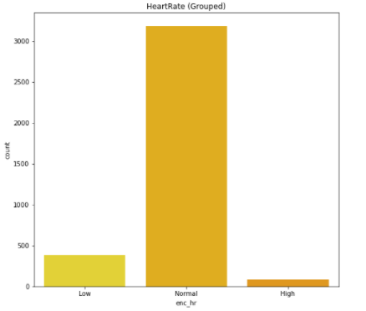
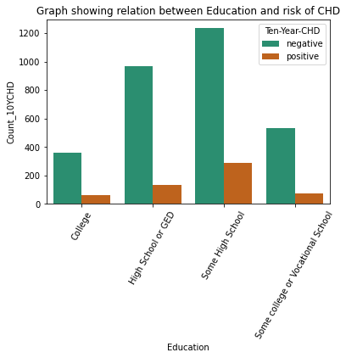
Age Group and Lifestyles!

Slide 8
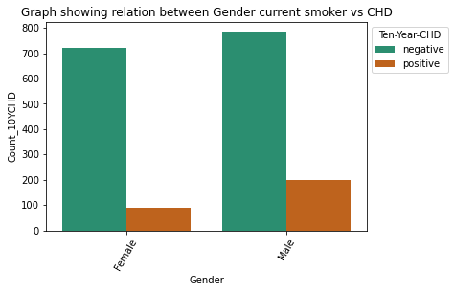
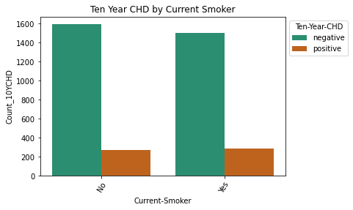
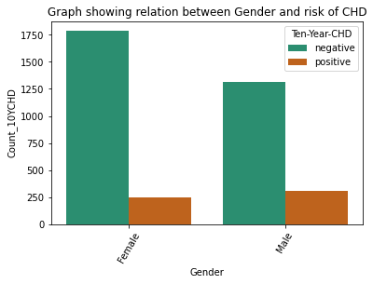
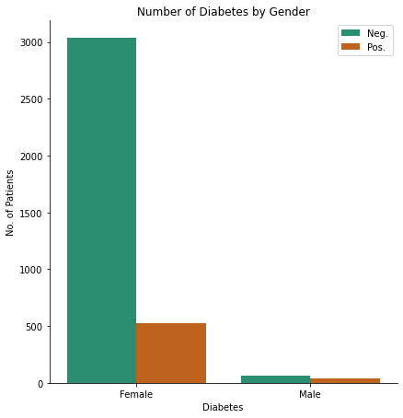
Count of CHD and some of critical factors based on gender
14.6%
15.9%
12.9%
18.9%
12.3%
Data shows both genders have high desire on smoke daily while, Female candidates are more susceptible against Diabetes. Approximately 15.9% people who smoked are risk of CHD and 14.6% who did not smoke are also at risk of CHD

Slide 9
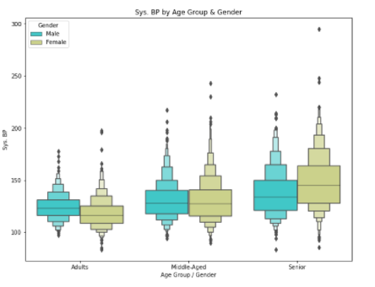
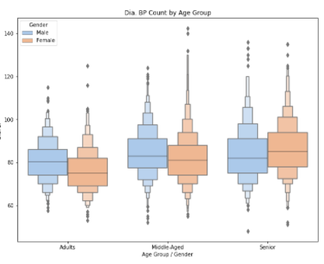
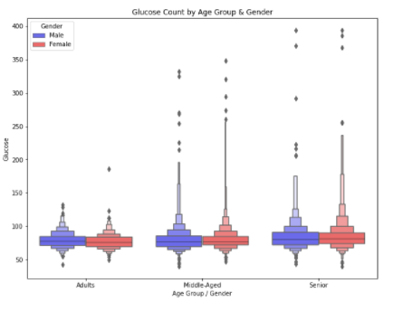
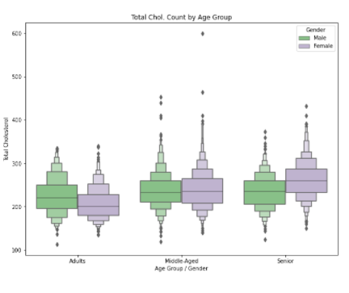
Sys. BP and Dia. BP are Increasing as age increase!
Glucose Count is Increasing as age increase!

Slide 10
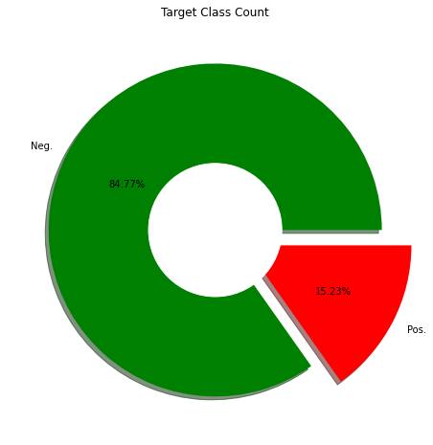
Education and total Target Count
1.64% of college education are at risk of CHD compared to some high school education are about 7.8% at risk of CHD. This could be due to less access to Health care or low income for people who has some high school education.

Slide 11
Thank you for your attention!

